Slide 1
PcVuePortableのご紹介
完全Webポータル対応 － WebポータルSCADA
株式会社PcVue Japan

Slide 2

目次
製品概要
1
製品機能紹介
2
製品特徴
3
主な実例
4
製品仕様
5

Slide 3
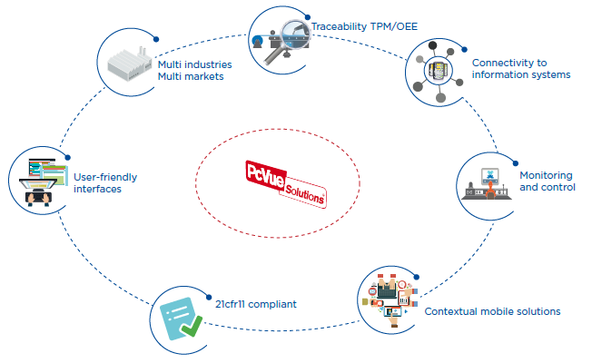
PcVue Japanの取組み課題
システム統合
大規模 Databaseを活用したDashboard対応
⇒SCADA全般の課題
PcVue強み
⇒ SNMP･Universal Data Connector
大規模化・多種接続
Web3D画面対応・大規模 Database化の信頼性向上
⇒SCADA全般の課題
PcVue強み
⇒ GIS･SnapVue
⇒ PcVue built-in
課題対応を強化して、PcVueの汎用性を更に伸ばす
Notes:
To meet the constraints of modern industries, PcVueSolutions, a
suite of softwares independent from constructors and providers,
brings more than 30 years of experience and innovation for
industry market.
The needs :
Monitoring and control for any kind of industrial installations for the production or the facilities
Connecting heterogeneous devices and standardizing operation modes
Securely ensuring the continuity of the production
Optimizing the operations and maintenance of the production tools
Ensuring the traceability of production data
Reducing cost of system updates (development, operator training)
Benefit from sustainable solutions which can be autonomously managed by final users
With a rich HMI, connectivity to any kind of devices, full reporting
capabilities, and innovative tools for maintenance PcVueSolutions offers
a unique platform for industries.
Our Solutions :
Built-in support of the standard drivers of automation and control devices
Optimized management of alarms, trends and events for the operation and the maintenance
Ergonomic and user-friendly graphical interface, adaptable to all types of processes
Single development platform including an intuitive configuration environment
Interoperability ensured with the global system of your company : ERP, CMMS, quality, IT
Flexibility and scalability : from a single station to client-server architecture
Built-in support of the 21cfr11 standard
Contextual mobility solutions to facilitate the work of the operator

Slide 4

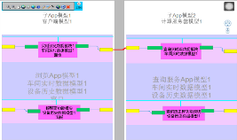
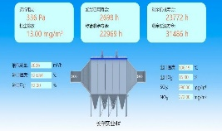
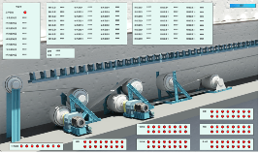
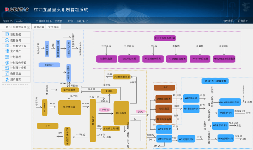
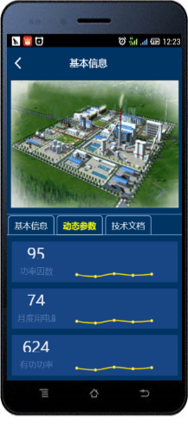

システム構成
エンジニアリング構成 プロジェクト操作閲覧 設備生産モニタリング プロセス生産監視 部門間コラボレーション スマートAPP
アプリケーション側
PcVue
Portal
プラットフォームシステム
グラフィカルインターフェース
イベントシステム
モデル
Canvas
アラーム/イベント表示
uiコントロール
ピクセルレベルの合成
Svg/CAD
作業フローチャート
チャート
業界チャートのコンポーネント
アニメーション接続
基本的なグラフィックモデル
グラフィカル構成ソフト
Web GL
3Dプロセスのフローチャート
工場GIS
2Dプロセスのフローチャート
スクリプトイベント
（グローバル、ページスクリプト）
結合モデル
ビデオ
KSプロジェクト変換
豊富な表示効果
柔軟なシステム相互機能
再利用
拡散
restfulインターフェース
サードパーティのユーザーWeb製品
WebServer
データサービス
エンジニアリングサービス
ユーザーサービス
API
API
API
リアルタイムデータベース
(PcVue、PcVue OPC Server)
リレーショナルデータベース
(MySQL、SQLServer、Oracle)
産業データベース
(予定：Canary Labo)
组态产品 数据库
(KingIOServer、KingSCADA、KingView)
关系数据库
(MySQL、SQLServer、Oracle)
工业库
(KingHoatrian)
データ層

Slide 5

Data acquisition
Connectivity
Connected Platform
Wide built-in drivers 200+
OPC
Modbus IP, S7IP,…
SNMP
LoRa
SIEMENS, SCHNEIDER, Rockwell ABB,…
Advanced built-in features
Redundancy
Time stamped
…
Full interoperability
Software development kits
WebServices
OPC
A single data acquisition platform
High performances and reliability
Easy configuration

Slide 6


IoT
Connectivity
PcVue connects Things
An additional way to connect
IoT driver for LoRa
Easy to deploy architectures : wireless & self powered sensors
Objects seamlessly connected to PcVue
Support for hybrid solutions with legacy devices and new objects
Take advantage of the PcVue data treatment for your IoT

Slide 7
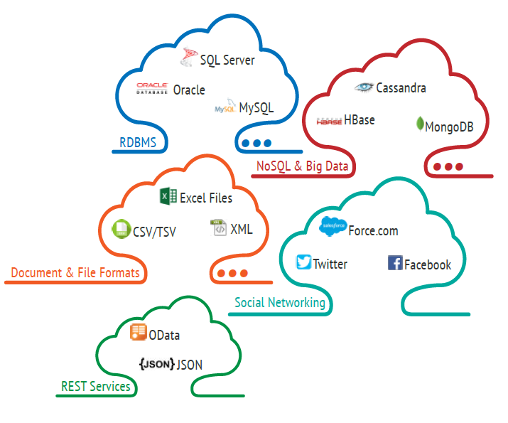
Universal Data Connector
Connectivity
Request handler for 3rd party on-premise/cloud-based RDBMS
Link to ERP,MES,CMMS, Facility
Management
Communication to Social
Networks
Connexion to REST Services

Slide 8
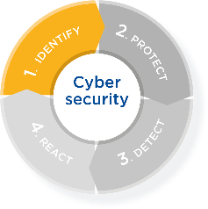
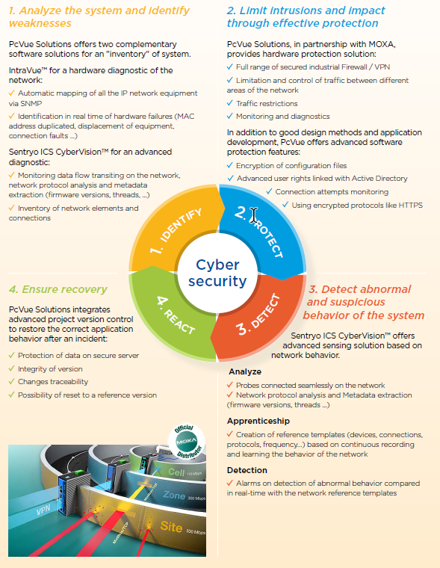
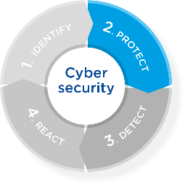
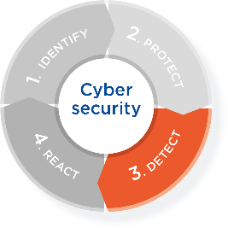
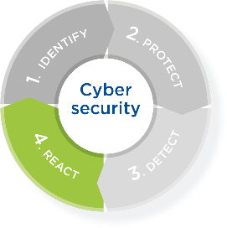
PcVueSolutions cybersecurity offer
Cybersecurity
Identify weaknesses
Monitoring data flow : Sentryo
Protect
Package installation sécurisé (Signature) : PcVue
Secure drivers (SNMP v3) : PcVue
Secure deployment (RDS, Virtualisation) : PcVue
User management (LDAP) : PcVue
Hardware network protection : Moxa
Detect abnormal behavior
Weaknesses detection : Sentryo
Log events: PcVue
React to ensure recovery
Reference status comparison : Sentryo
Cybersecurity alert (SIEM / SOC) : Sentryo
Project centralized version : PcVue

Slide 9




The use case: On-duty teams
Solution
Notifications
Using alerting systems is good
Share maintenance team costs over multiple sites
Actions taken with very few delays
Established in maintenance contracts for years
…But not enough…
Sound decisions requires more than a SMS
Detailed status of the process on site ?
Can/should it be fixed by the team on-site ?
And can save a lot of money
Your best friend is a smart phone
No need to
Call the site to get more information
Find a computer to connect to the site
Move from your sofa before you make up your mind
Go on site if not necessary

Slide 10
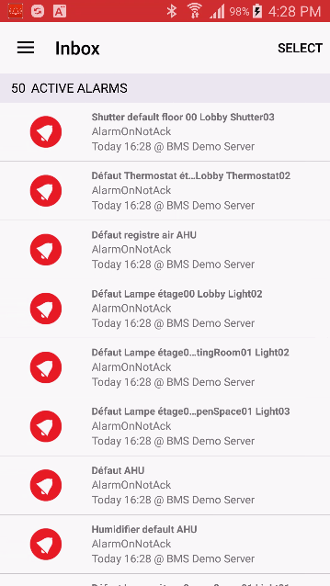
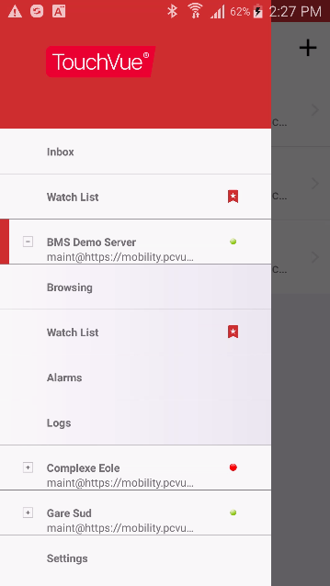
TouchVue 12 – At a glance
Solution
Notifications
Notifications
Notifications logs
List of variables to follow
Variables access
Multi site connexion
Real time alarms list
Recorded event logs

Slide 11
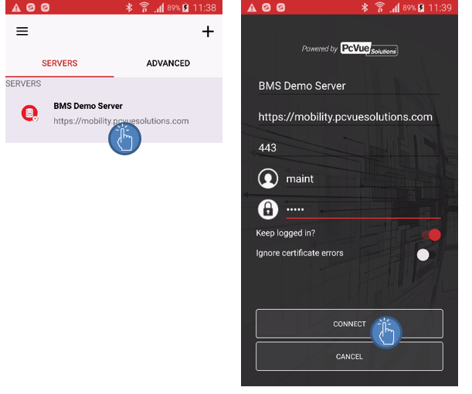
TouchVue 12 – Connection
Solution
Notifications
Server
Server access
Credentials

Slide 12
TouchVue 12 - Alarms
Solution
Notifications
When alarm goes off TouchVue allows :
To get relevant information
Access alarm detail
Control process
To get the context
Check setpoint values
Check trends
Checks alarms and events logs
To remotely take action
Acknowledge/mask alarms
Change a setpoint
Control a device
Take the right decision on site
Avoid a trip on site…

Slide 13
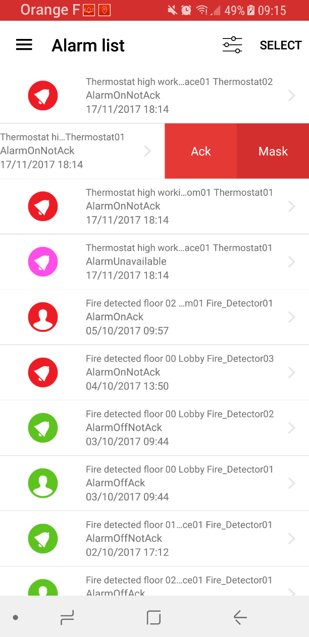
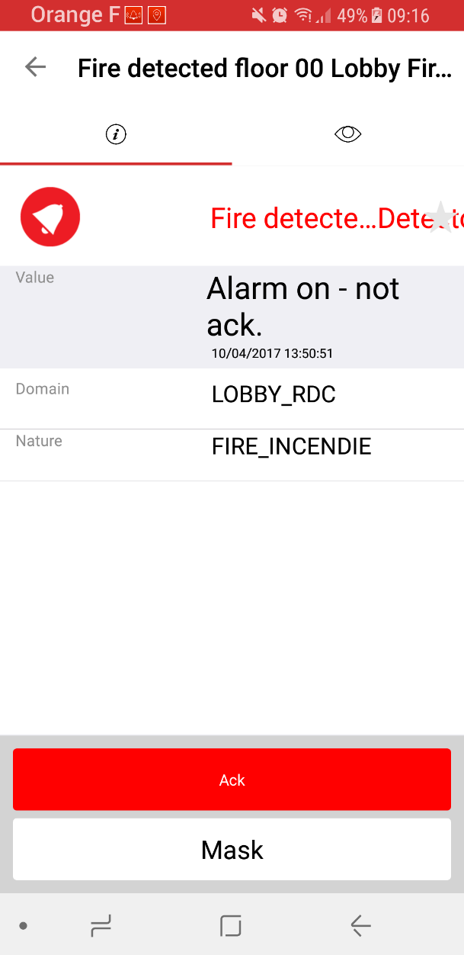
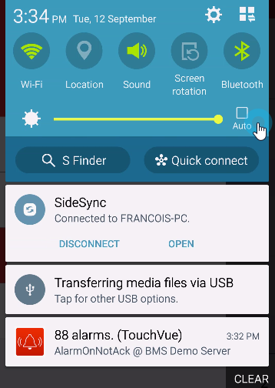
TouchVue 12 – Alarms
Solution
Notifications
Status &
name
Aknowledgment or mask
Selection
Status
Attributs
Notified alarms
Real Time list
Detail

Slide 14
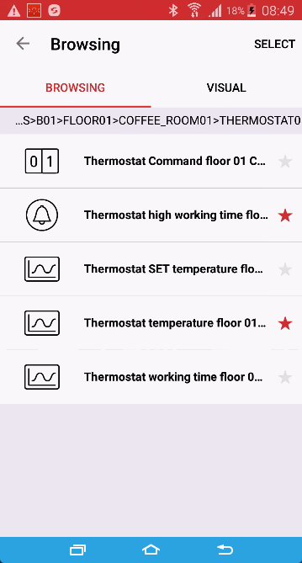
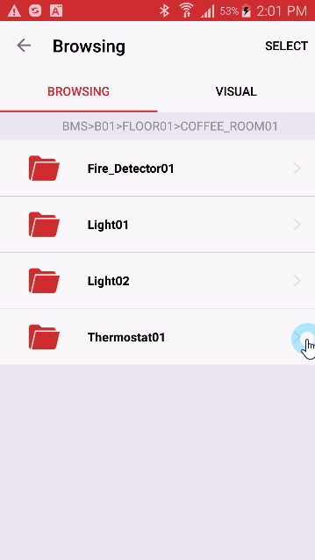
TouchVue 12– Real time data access
Solution
Notifications
Access real time information of your process
Monitor, control
Favorite variable
Variable tree

Slide 15
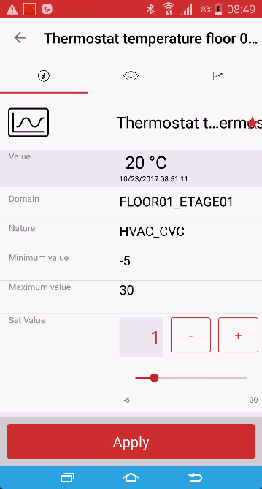
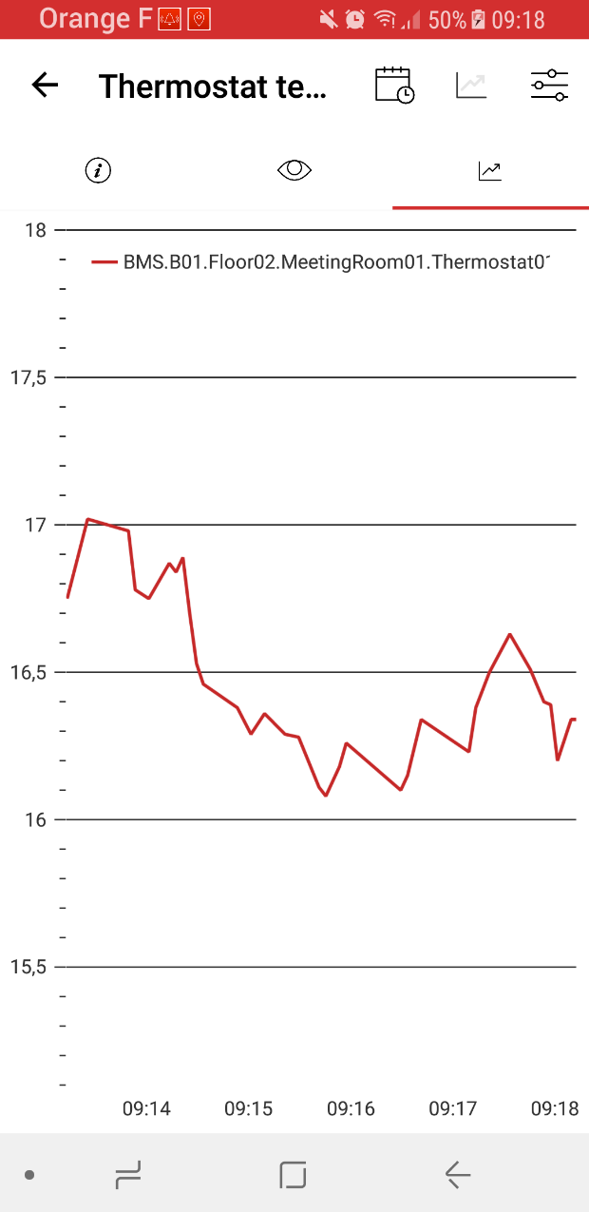
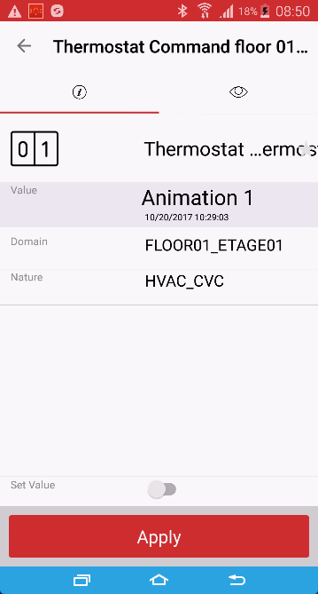
TouchVue 12 – Monitor & control
Solution
Notifications
Analog value
Bit

Slide 16

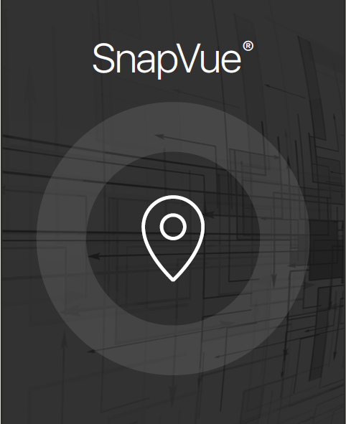
SnapVue
Location based
Solution
The contextual mobile app

Slide 17

Contextual mobility
Location based
Solution
The extension of your process
Exchange and visualize relevant information
on a mobile device in the context of location/role
Take advantages of geolocation technologies
Automatically push information to the mobile user
Allows the mobile user to interact in an intuitive way
- Without the need to navigate through menus
The right information
At the right place
At the right time
To the right people
Mobile app + Geolocation + Services

Slide 18
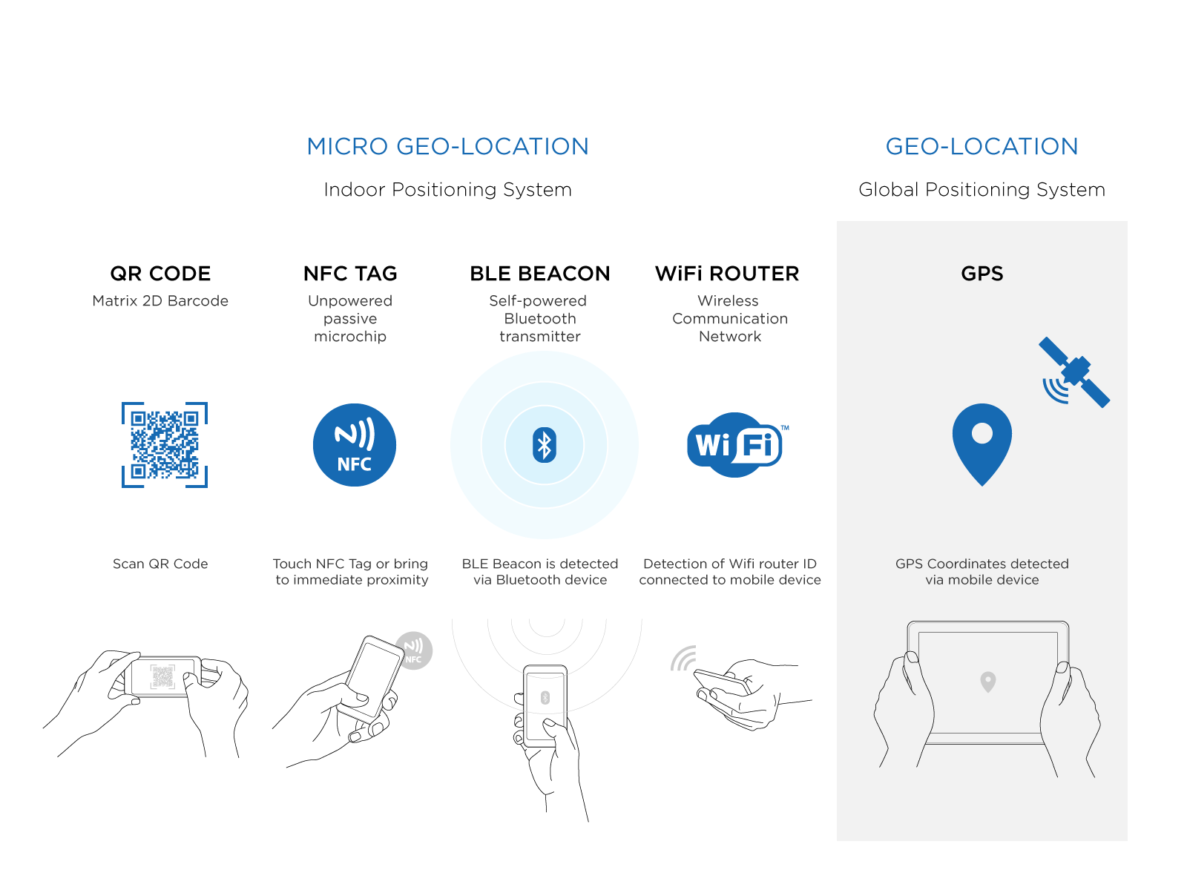
Location devices
Location based
Solution

Slide 19
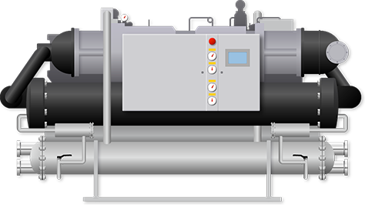



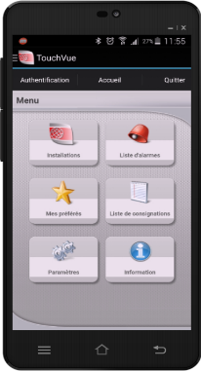
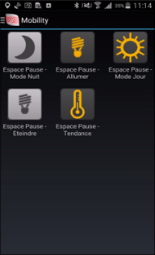
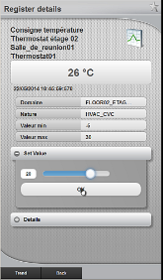
Maintenance operations
Location based
Solution
Scenario
Benefits
A Maintenance staff is performing maintenance task on an equipment.
They are facing a machine or equipment that has no HMI or operator Interface.
They scan the QR code or touch the NFC tag to visualize status and parameters.
They then set the equipment to maintenance mode masking alarms, then enter their maintenance actions & reports.
They can consult Manuals or Equipment datasheets as needed.
Provides a mobile interface to verify status live of connected equipment.
Improves safety as maintenance staff has full live information and data sheet/manual available
Can tune parameters according to overall system and visual reality on the spot
Intervention summary done on the spot and immediately recorded on central system
Automatically provides the correct information depending on where the maintenance staff is
All Industries, Infrastructures and BMS applications.

Slide 20

01
製品概要

Slide 21









PcVuePortal
製品機能
2D設備図
GISマップ
チャート部品
ビデオ（プラグインなし）
2
4
6
8
3
7
9
1
5
データソースのサポート
3D設備図
UIコンポーネント
ユーザーと権限の管理
スマートAPP

Slide 22
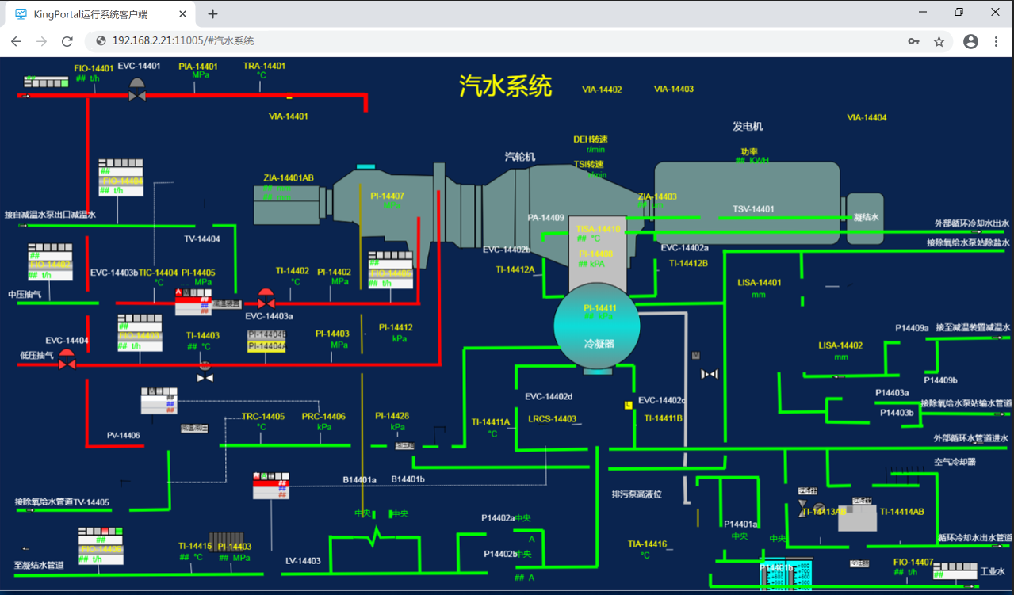
2D設備図
PcVuePortal
2Dグラフィカルモデルエディターの提供
16の基本図形と各業界の3000以上の機器グラフィックスを搭載。設備図を個別に作図可能。
SVGベクター（AIソフト等エクスポート）インポートをサポートし 無段階ズーム可能。
CAD図面のインポートとエンジニアリング設計図面の迅速な再利用をサポート。
28種類のアニメーション作成、究極のシンプルコンフィグレーション
様々な形式の表示効果に対応

Slide 23
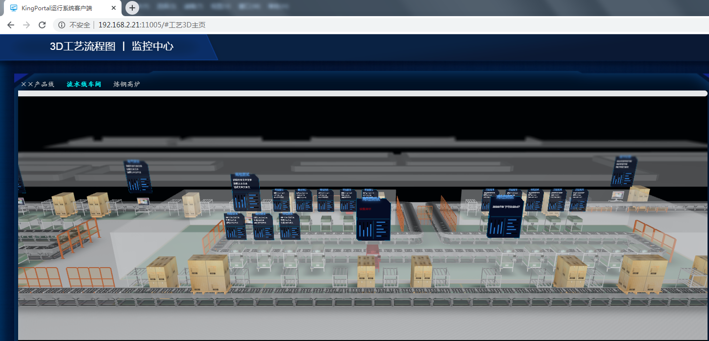
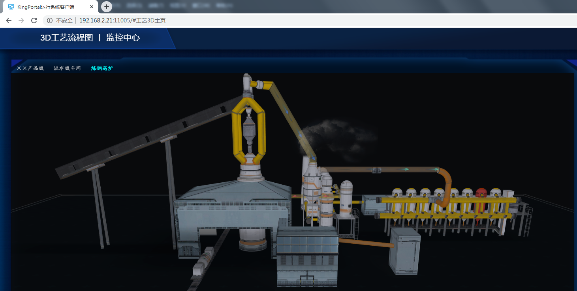
3D設備図
PcVuePortal
柔軟な3D画面の構築
obj形式のインポートをサポート（Adobe 3DMAXソフトウェアなどを本ファイル形式に変換可能）。
3D構成の再編集をサポート。
豊富な3D画面の表示機能
3D表示効果はリアルでフレンドリー。
PcVuePortal
回転、ズーム、ローミング操作をサポート。
3D画面と産業データの完全な統合
3Dエディターを提供し工業用データとアニメーションを構成可能。
クラフトデータ駆動型アニメーション、アラームの自動制御、機器のシミュレーション、データの結合などをサポート。

Slide 39
01
製品概要

Slide 45
Position

